Slide 1
Machine Learning (MSc in Data Science)
Paco (Francisco Perez-Reche)
fperez-reche@abdn.ac.uk

Slide 2
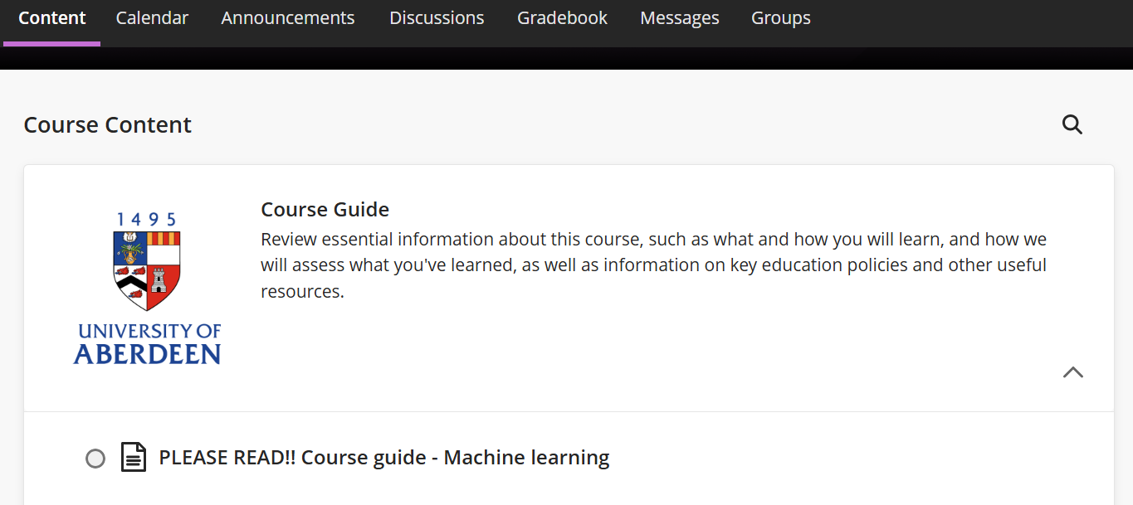
Course guide
This presentation mostly covers information that is also available in the course guide of MyAberdeen

Slide 3
Aims and Learning Outcomes

Slide 4
Aims of the course
Main aim: understand how computers can be taught to learn from data
Train you to be able to use machine learning to address many important questions that can be addressed using data
What is machine learning?
What can machine learning do?
… and what it cannot do

Slide 5
Aims of the course
Probability and probability distributions.
We can teach machines from data but predictions will often be probabilistic.
In fact, humans also make probabilistic predictions. For instance, "it might rain", "I might win the lottery" often have an associated probability (chance).
Machine learning in practice. The course has a marked practical focus.
How does machine learning work?
What are the methods by which computers learn?
Despite the practical focus, we will look at key methods in some detail.

Slide 6
Spirit of the course
To cover many aspects of machine learning.
To understand well what we do, not to cover all and every aspect of machine learning (impossible in a single course and would require a lot of maths and statistics...).
Practical focus is emphasised (but key theoretical aspects will be covered as well).
Typically illustrate concepts with examples and build up a more general understanding in a gradual manner.
We will mostly use clean datasets since the main goal of this course is to do machine learning, not data preparation.

Slide 7
Teaching organisation & assessment

Slide 8
Teaching organisation
Course components
Lectures
On-campus or online
Practicals
On-campus or online
Assessments
Online

Slide 9
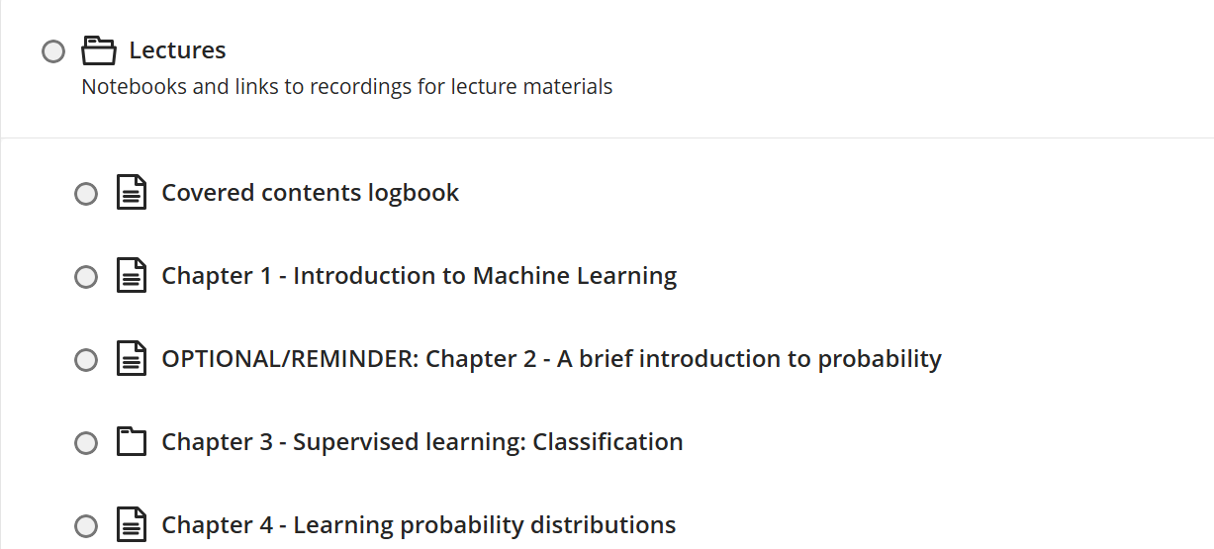
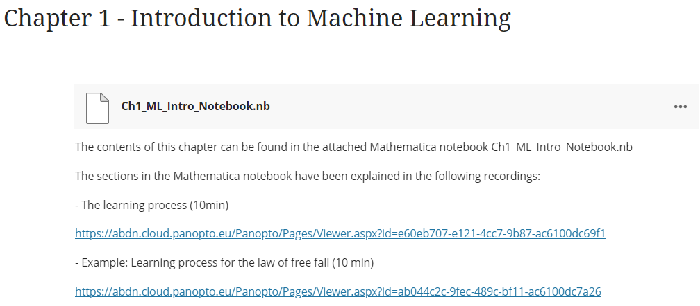
Lectures
Explain concepts
On-campus and recorded
Notebooks
Recordings

Slide 10
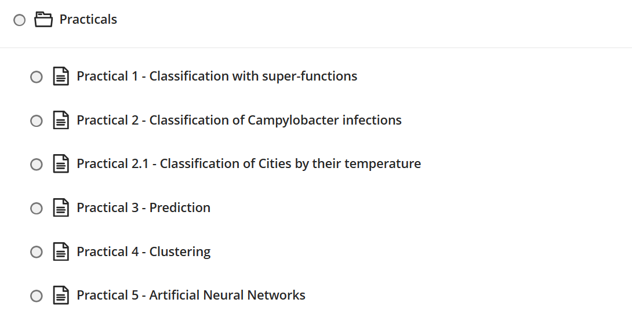
Practicals
After following lectures, you do practical work
Also “TASKS FOR YOU” in lecture notebooks

Slide 11
Assessment
Assessment 1:
Contribution to final mark: 1/2
Online
It is about supervised learning (Chapters 3, 4 and 5).
Open for 3 days. To be completed in a time window of 3.5 hours once you start it.
Assessment 2:
Contribution to final mark: 1/2
Covers all chapters (registered in the logbook by the end of the course).
Open for 3 days. To be completed in a time window of 3 hours once you start it.

Slide 12
Assessment – Dates
Assessment 1:
From Thursday 30 April at 00:00 to Saturday 2 May at 23:59.
Assessment 2:
From Friday 15 May at 00:00 to Sunday 17 May at 23:59.
Remark: These dates apply to all students in the course.

Slide 13
Course contents

Slide 14
Course contents
Weeks 1,2:
Lectures:
Chapter 1 - Introduction to Machine Learning
Chapter 2 - A brief introduction to probability (a reminder, mostly covered in previous courses so not covered in detail in our lectures)
Chapter 3.1 - Supervised learning: Wolfram Language built-in functions for classification (a reminder, mostly covered in previous courses so not covered in detail in our lectures)
Chapter 3.2 - Training a classifier with labelled inputs
Chapter 3.3 - Classification with K Nearest Neighbours (KNN)
Practical exercises: Practical notebooks 1 and 2. Also “Tasks for you” set in lectures.

Slide 15
Course contents
Weeks 3,4:
Lectures:
Chapter 4 – Learning probability distributions
Chapter 5.1 - Predicting numerical values
Chapter 5.2 - Predicting sequences
Chapter 6 - Unsupervised learning: Clustering
Practical exercises: Practical notebooks 2, 3 and 4. Also “Tasks for you” set in lectures.
Weeks 5,6:
Lectures:
Chapter 7 - Logistic regression
Chapter 8 - Artificial Neural networks
Chapter 9 – Machine learning with Python
Practical exercises: Practical notebooks 4 and 5.

Slide 16
Bibliography

Slide 17
Bibliography
No specific book is followed in the course. However, you may find some books in this list useful:
Paul Wilmott "Machine Learning: An Applied Mathematics Introduction", Panda Ohana (2019)
Explains how some key methods work. Gives mathematical details but they are introduced in a pedagogical way. Contains interesting examples. Very enjoyable.
Not available online but in print version is not too expensive.
Etienne Bernard “Introduction to Machine Learning” Wolfram Media (2021).
Based on Wolfram Language. Covers well the basics of machine learning.
https://www.wolfram-media.com/products/introduction-to-machine-learning.html
Aurélien Géron "Hands-on Machine Learning with Scikit-Learn, Keras & TensorFlow", O'Reilly (2019)
Machine learning with Python. [https://abdn.primo.exlibrisgroup.com/permalink/44ABE_INST/1jd70l9/alma9918477297305941]

Slide 18
Bibliography
Jeremy Watt, Reza Borhani, Aggelos K. Katsaggelos "Machine Learning Refined: Foundations, Algorithms, and Applications" Cambridge University Press, 2nd Edition (2020)
More in depth coverage of key mathematical concepts such as optimization. The algorithms used in the course involve these methods but we will not focus on these mathematical details in depth.
[https://abdn.primo.exlibrisgroup.com/permalink/44ABE_INST/tvkctg/cdi_askewsholts_vlebooks_9781316402276 ]
Kevin P. Murphy "Machine Learning: A Probabilistic Perspective" The MIT Press (2012)
Very complete. It might be mathematically challenging. Goes well beyond this course.
Available online from library: https://abdn.primo.exlibrisgroup.com/permalink/44ABE_INST/1jd70l9/alma990016075260205941

Slide 19
Assistance - Contact

Slide 20
Assistance - Contact
Do not hesitate to get in touch if you have questions
Important: Talk to us before you get lost or utterly disappointed :-)
Practical sessions are ideal to ask questions and discuss
Contact:
Lecturer: Paco Perez-Reche (fperez-reche@abdn.ac.uk). 158 Fraser Noble.
Practicals: Pakayal Boar (p.boar.23@abdn.ac.uk).
School office: Rowena Hardy (ncspgt@abdn.ac.uk)

